Slide 1
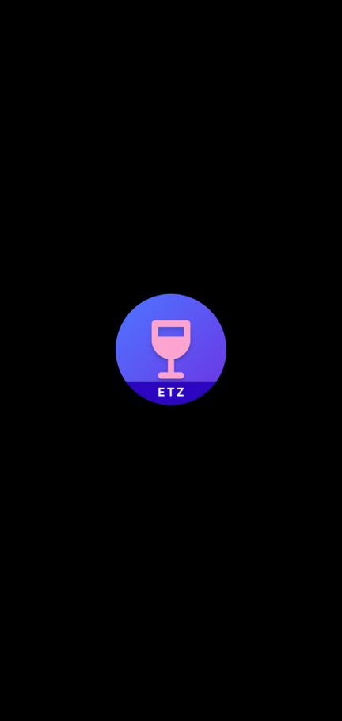


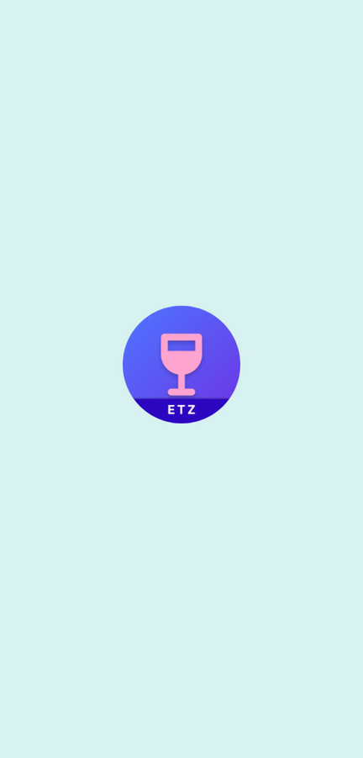

ETZ-COCKTAILS
APPLICATION
SHOWCASE

Slide 2


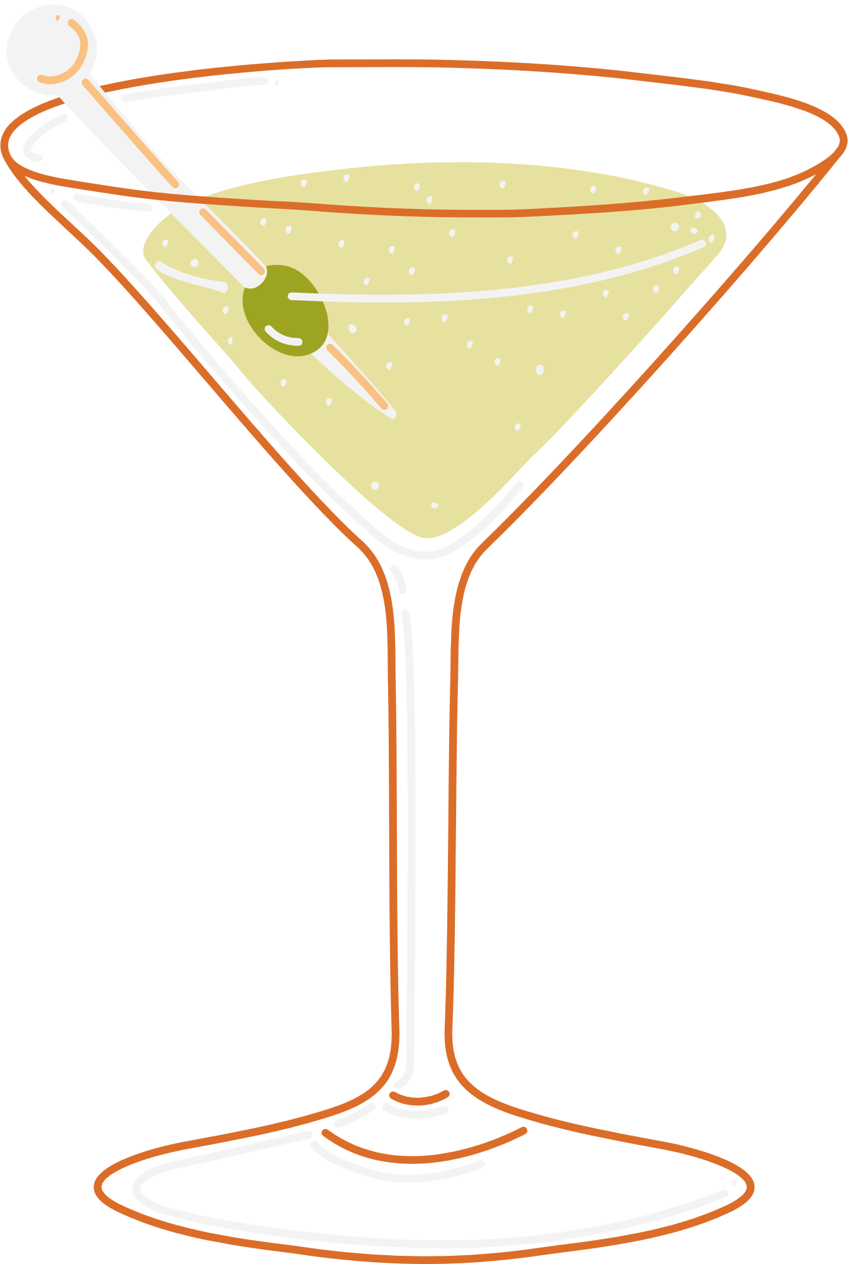
FIRST,
WHAT IS A COCKTAIL?
A cocktail is an alcoholic mixed drink. Most commonly, cocktails are either a single spirit or combination of spirits, mixed with other ingredients such as juices, flavored syrups, tonic water, shrubs, and bitters.
In modern times, the term cocktail has also come to refer to any mixed drink that contains three or more ingredients, without a spirit.
(check Wiki Link for more information)

Slide 3
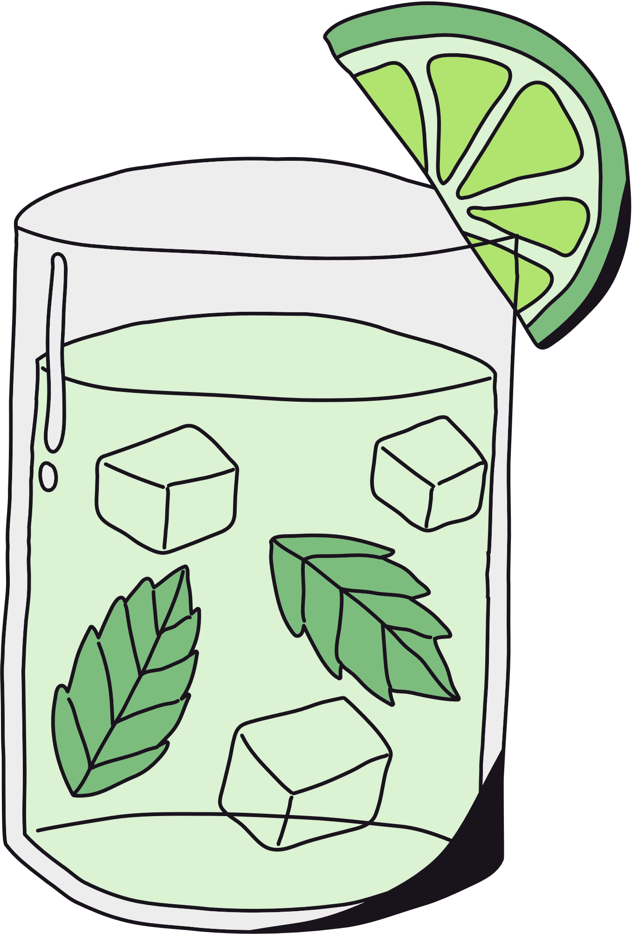
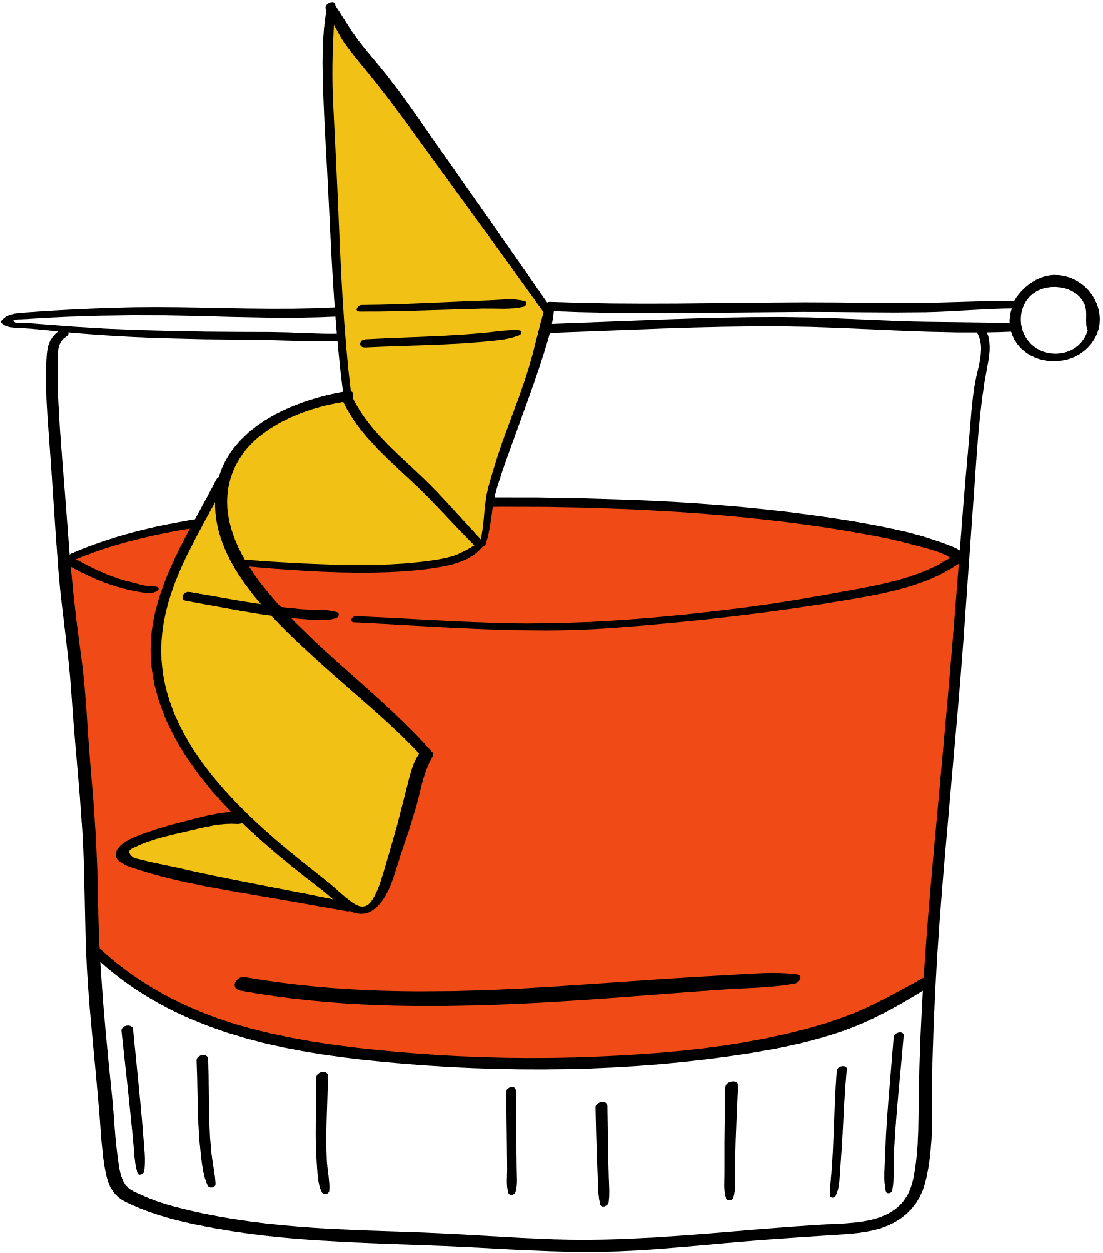
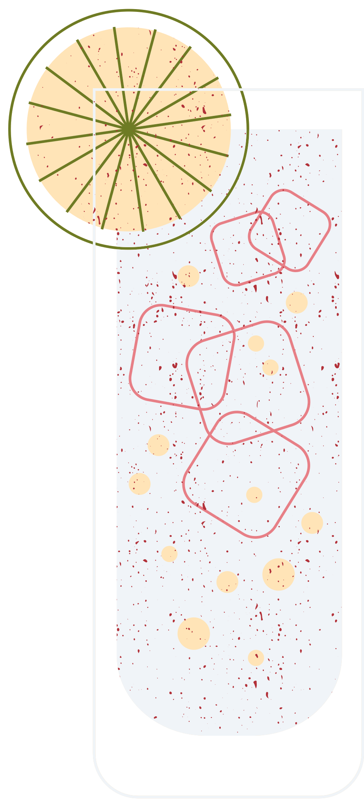
TEAM MEMBERS FAVORITE COCKTAIL
EYTAN RAHLIN
TONY HASSON
ZIV SIMCHONI
CLASSICAL GUY - OLD FASHIONED
AS HIS NICKNAME SUGGESTS - GIN & TONIC
TRADITIONAL AND REFRESHING -
MOJITO
A gin and tonic is a highball cocktail made with gin and tonic water poured over a large amount of ice usually with cucamber or lemon garnish.
The mojito is the epitome of the refreshing cocktail, stripped down to just the bare essentials of rum, lime juice, sugar, soda water, and mint.
The old fashioned is a cocktail made by muddling sugar with bitters and water, adding whiskey, and garnishing with an orange slice.

Slide 4
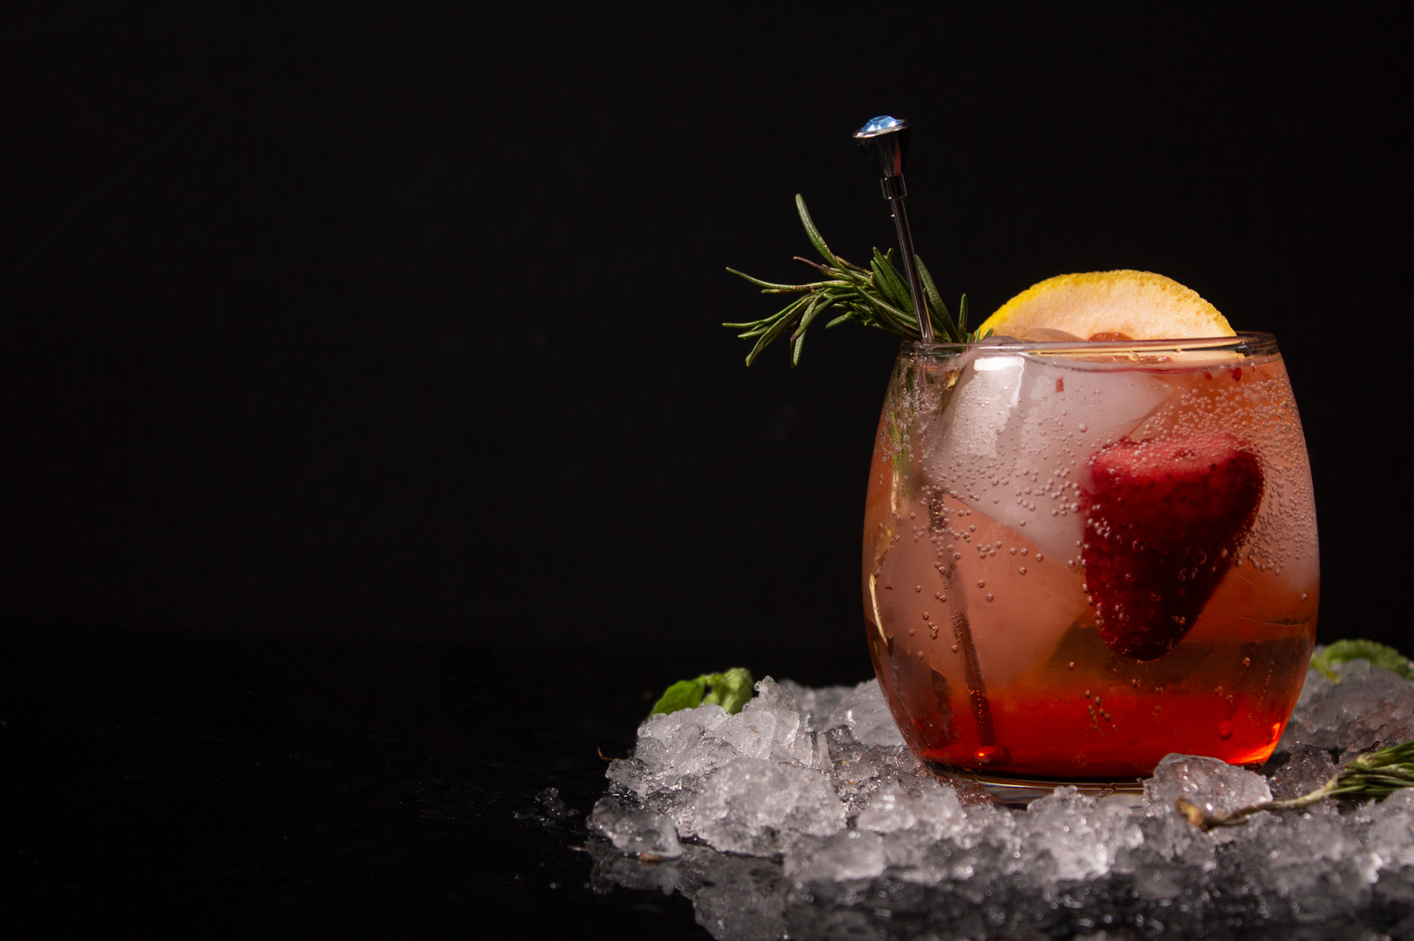

APP SUMMARY
The app idea is for ETZ Cocktails, a platform that allows cocktail enthusiasts to discover, save, and favorite drinks. The app provides access to a vast database of cocktail recipes, which users can easily search by name or ingredient, view detailed instructions, and save their favorite recipes all in one place. With its user-friendly design and comprehensive features, ETZ Cocktails streamlines the cocktail-making process and makes it easier for users to create delicious drinks.
WHY THIS IDEA?
APP GOAL
We were inspired to create ETZ Cocktails because of our shared passion for cocktails. Our goal is to provide a platform for all cocktail enthusiasts to discover, create, and save their favorite drinks with ease.
The goal of the app is to bring the joy of cocktail-making to everyone and provide an easy-to-use platform for discovering and managing cocktail recipes.

Slide 5


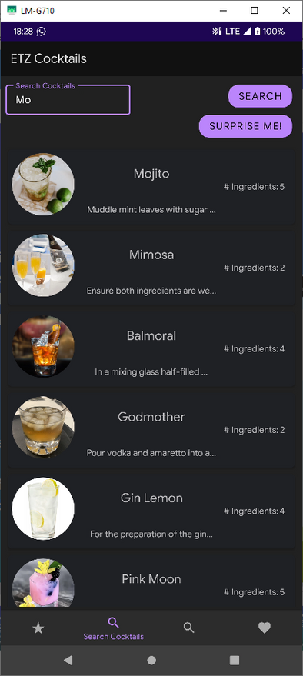
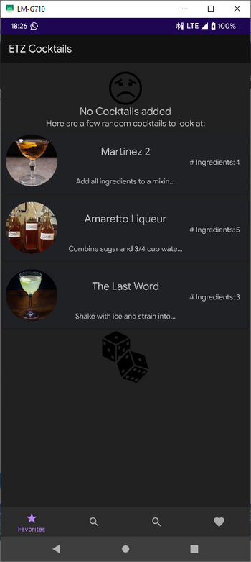
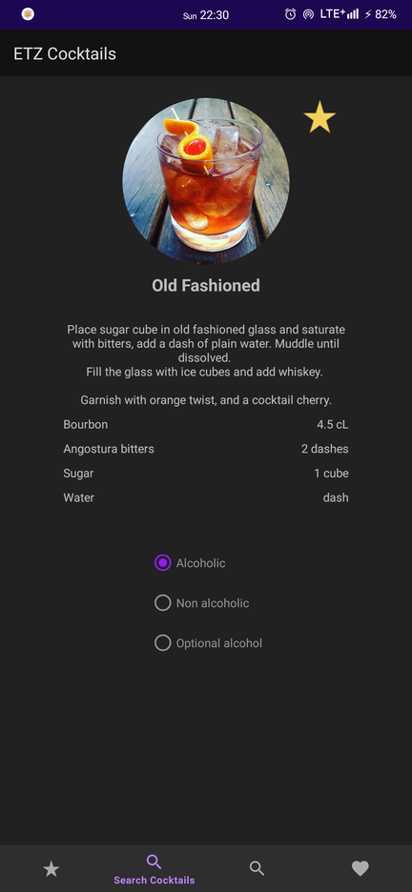


INTRODUCING
OUR BEST APP YET
EASY TO USE
WORK EASIER
A Minimalist User-friendly interface that makes it easy to navigate and find what you need. offer easy and intuitive experience.
Find your perfect cocktail with ease by searching by its name or any of its ingredients.
WORK ANYTIME
PERFECT FOR YOU
The application operates both offline and online.
Online: Fetch data from an API
Offline: View & modify saved cocktails.
Whether you're at home or behind the bar, manage your cocktail recipes and create new and exciting drinks.

Slide 6
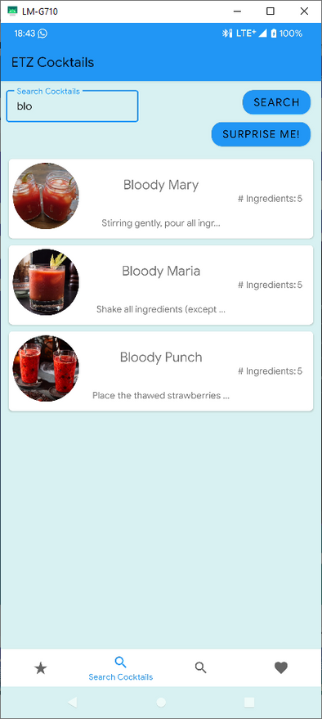
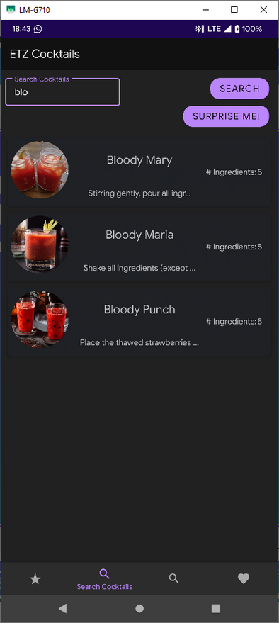



UI FEATURES
EASY TO CONTROL
No-Nonsense Navigation with intuitive and responsive UI.
DATA PREVIEW
Card view that allows the user to preview the instructions and to see the thumbnail of the cocktail, along with its name.
2 THEMES
Light mode - Blue & White color palette.
Dark mode - Purple & Black color palette.

Slide 7
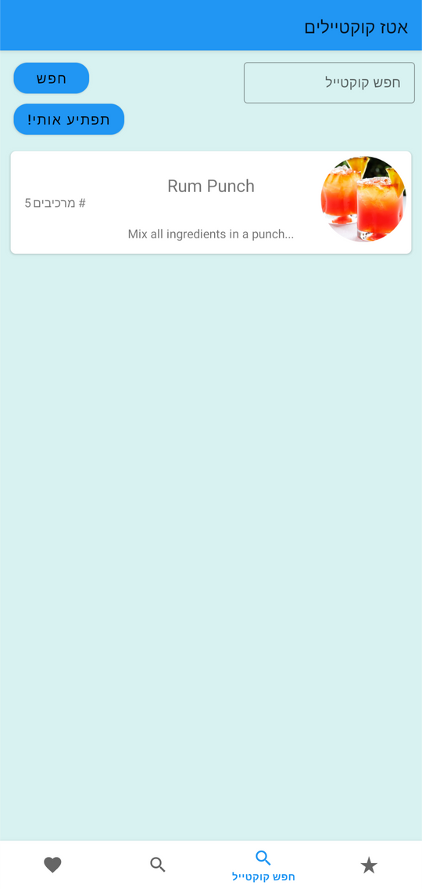
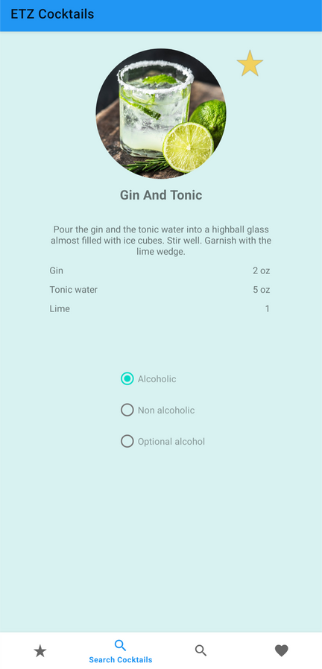

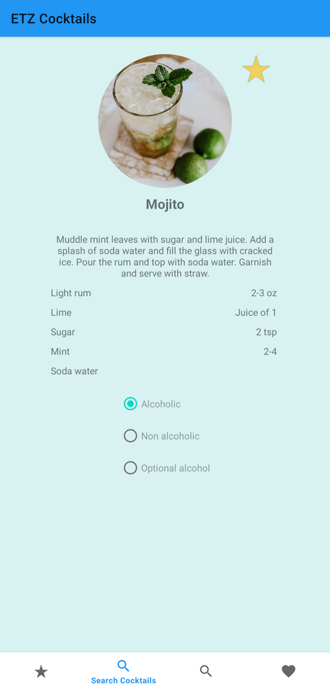

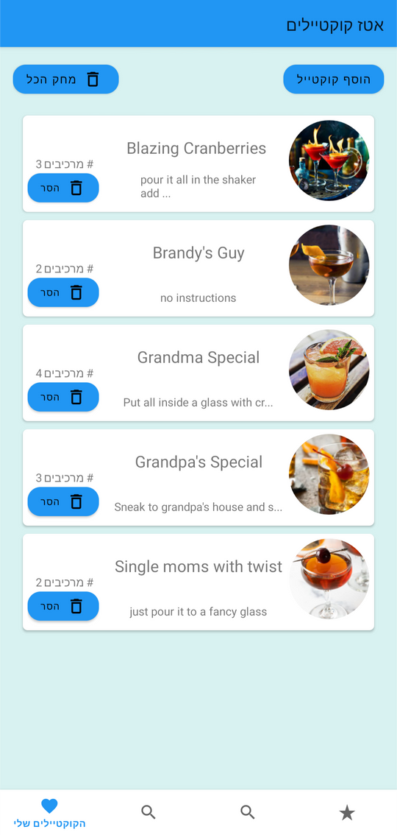

OUR PURPOSE
MAKING THIS APP
WORK EFFECTIVE & ORGANIZED
We provide a platform for cocktail lovers, mixologists, and bartenders to search for, create, and save their favorite cocktail recipes in one place.
Much better and more reliable than hand-written recipes or dumping recipes in the note app.
ONE-STOP APP
Access a vast database of cocktail recipes at your fingertips. You can easily search for cocktails by name or ingredient, view detailed instructions and save your favorite recipes all in one place.
CONVENIENCE WHILE WORKING EVERYWHERE
The application operates both offline and online.
While online you can access the cocktails DB,
either way you can access your saved cocktails.

Slide 8

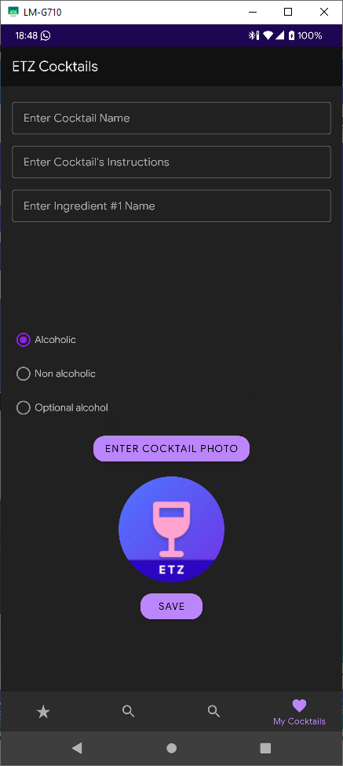
ETZ COCKTAILS SCREENS & FRAGMENTS
SCREEN ONE - FAVORITE COCKTAILS
First it suggests the user for random cocktails
afterwards will show a list of user's fav cocktails.
SCREEN TWO - SEARCH COCKTIALS
Allows the user to search by name or get a surprise - random cocktail.
empty search will show a list by abc ASC.
SCREEN THREE - SEARCH INGRIDIENTS
Allows the user to search an ingridient and will show a cocktail list that contains that ing
SCREEN FOUR - MY COCKTAILS
First it shows a sad face - its empty there.
afterwards will show a list of user's custom cocktails
SCREEN FIVE - ADD COCKTAIL
In this Fragment the user will create their own cocktails.
SCREEN SIX - SINGLE COCKTAIL VIEW
This screen shows the single cocktail in detailed view, user will be able to edit any cocktails that they've created.

Slide 9


OUR TARGET AUDIENCE
AS FOR THE AGE
The target audience for ETZ Cocktail app includes anyone who loves cocktails, such as cocktail enthusiasts, amateur and professional mixologists, bartenders, or anyone who wants to learn about cocktails and try new recipes.
There is no specific age for the target audience of ETZ Cocktail app, as the love for cocktails and interest in mixology can be found in individuals of all ages.
However, it's likely that the app would be more popular among adults who are legally allowed to consume alcohol, typically 21 years old or older in many countries and specifically 18 in Israel.

Slide 10
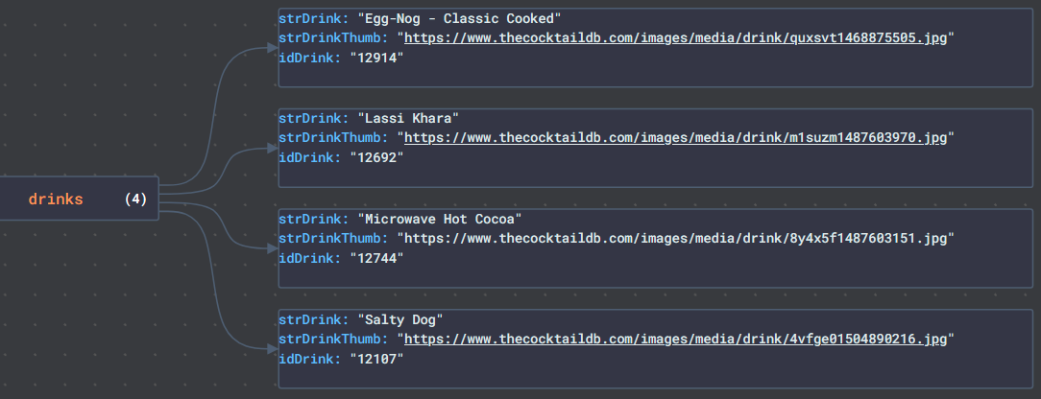
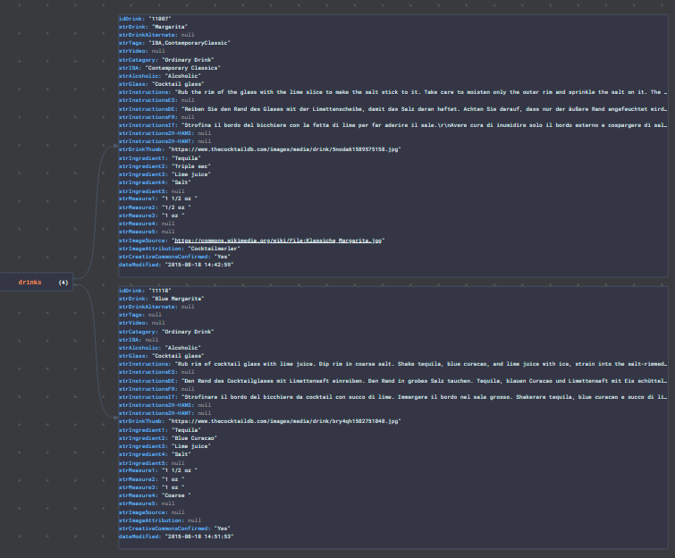
THE COCKTAIL OBJECT
TheCocktailDB API
Example for API Response @query for ing="salt"
Example for API Response @query search cocktail name = "margarita"
Cocktail Object Structure:
idDrink (int)
strDrink (string)
strAlcoholic (string)
strInstructions (string)
strDrinkThumb (string)
strIngredient1 - strIngredient5 (string)
strMeasure1 - strMeasure5 (string)

Slide 11
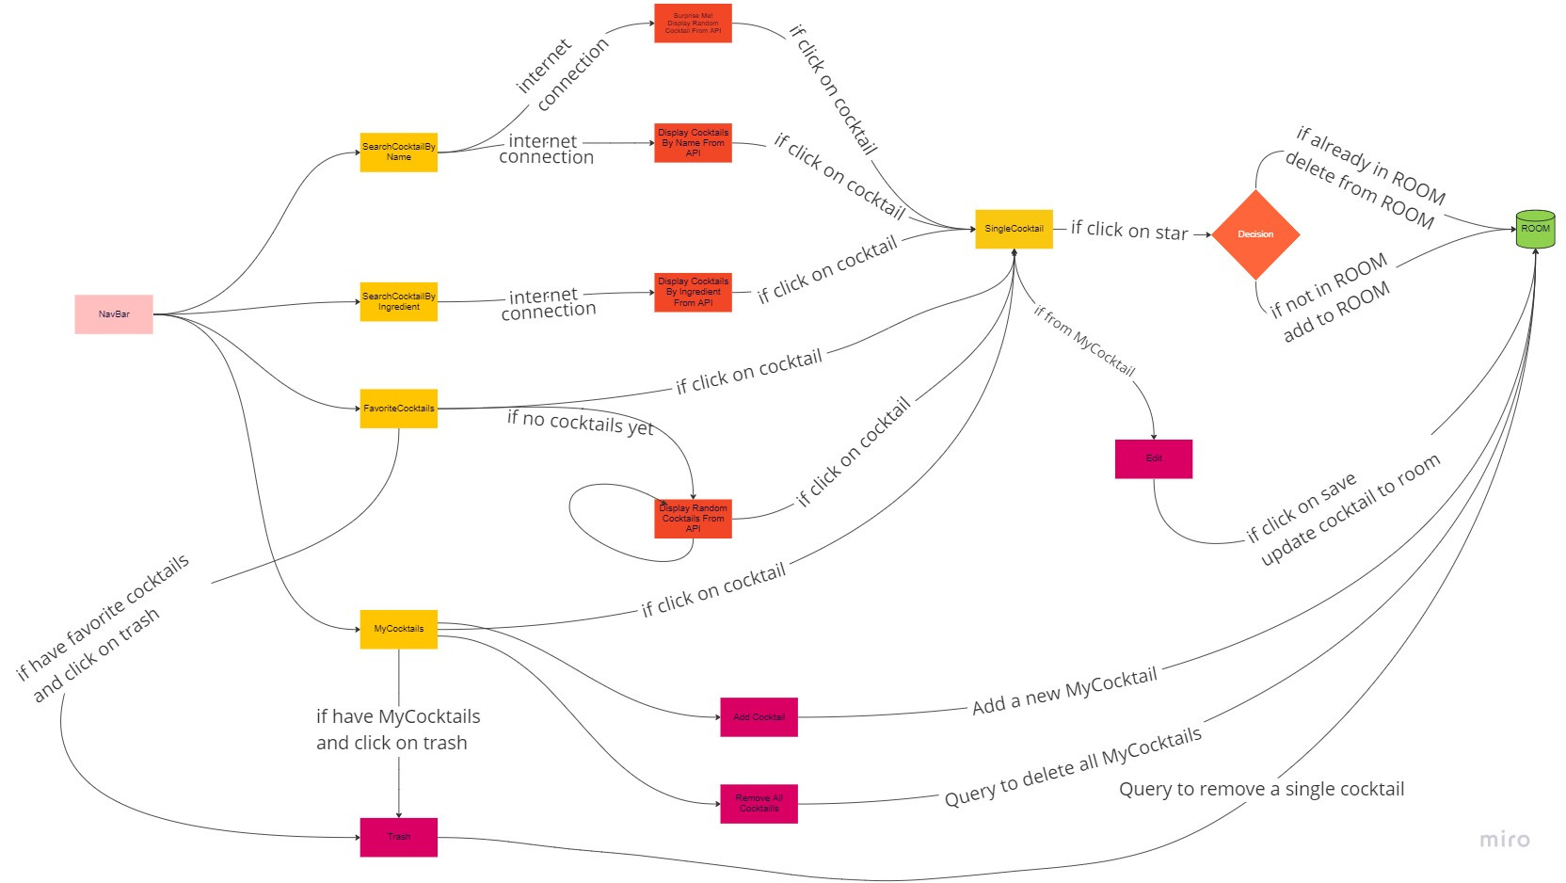

Slide 12
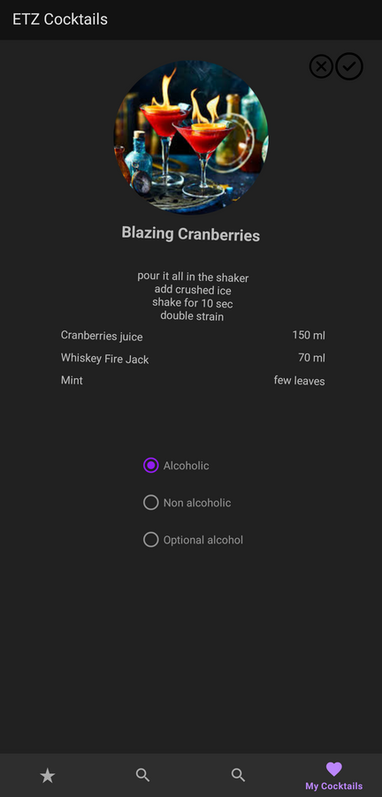
FUTURE ROADMAP
& FEATURE TODO LIST
MORE ANIMATIONS
INTEGRATE MORE APIS
Give user user the option to chose integration between multiple Remote Databases
SETTINGS PAGE
A page that'll contain all the settings
ABILITY TO SHARE CUSTOM COCKTAILS ONLINE
USER CUSTOM THEMES
Give user user the option to chose between multiple themes and create their own theme.
PRIVACY POLICY PAGE
A page that'll contain the app privacy policy
LICENSE AND CREDITS PAGE
A page that'll contain all relevant credits and lisences
EXPORT COCKTAILS

Slide 13
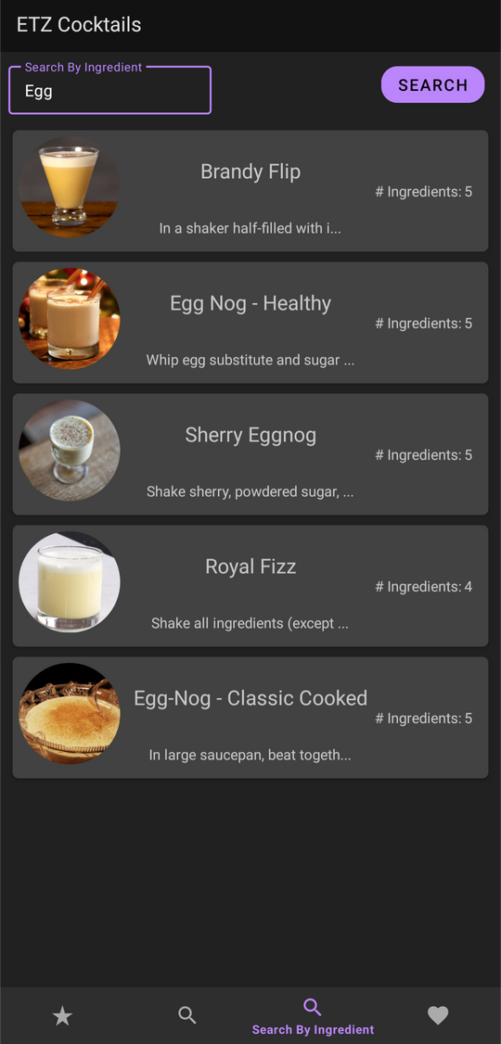
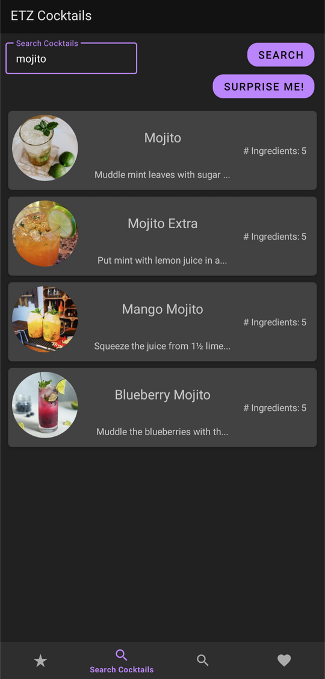

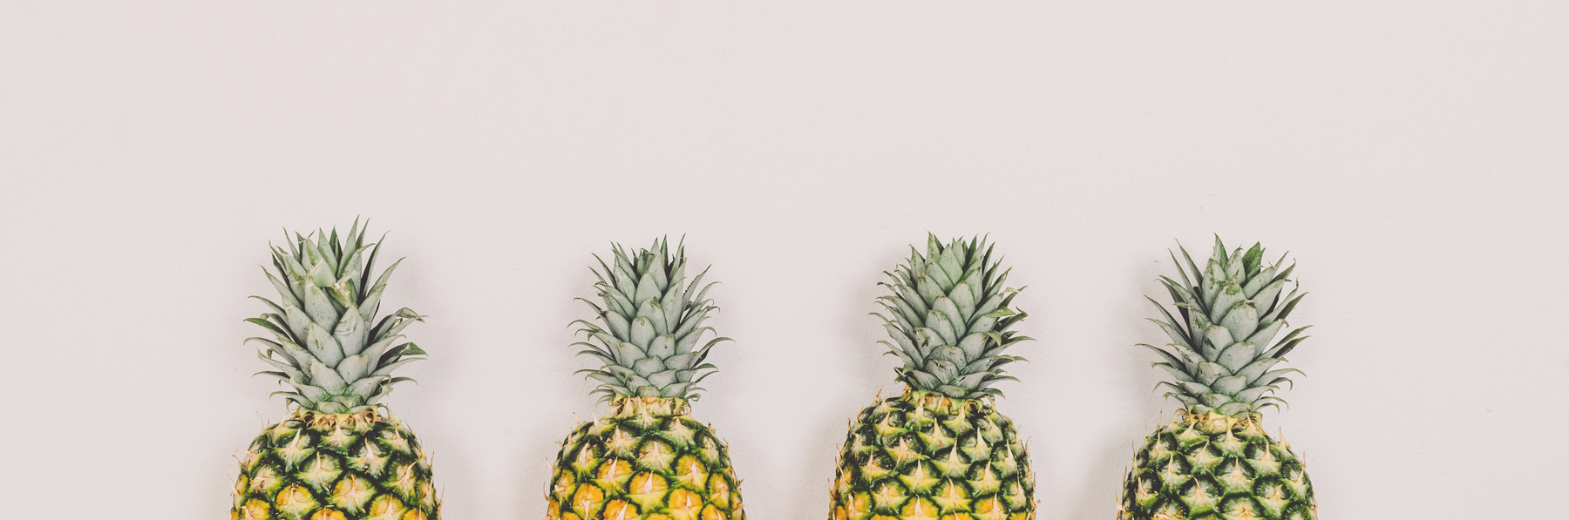
MOBILE VERSION
SHOWCASE

Slide 14
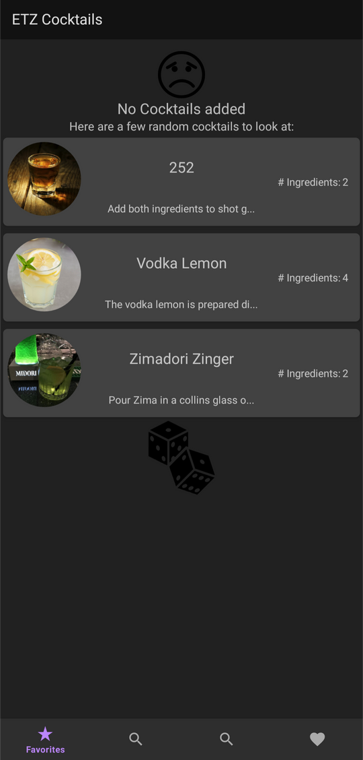
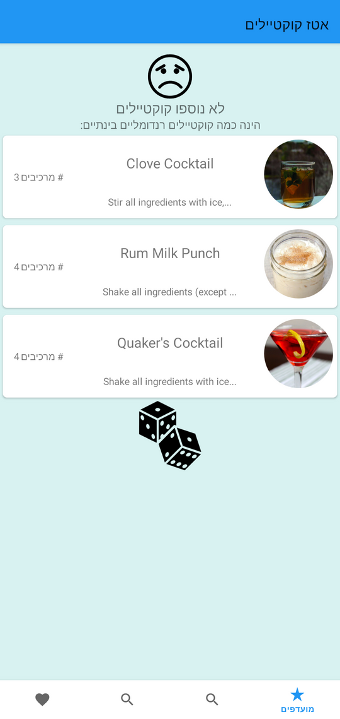
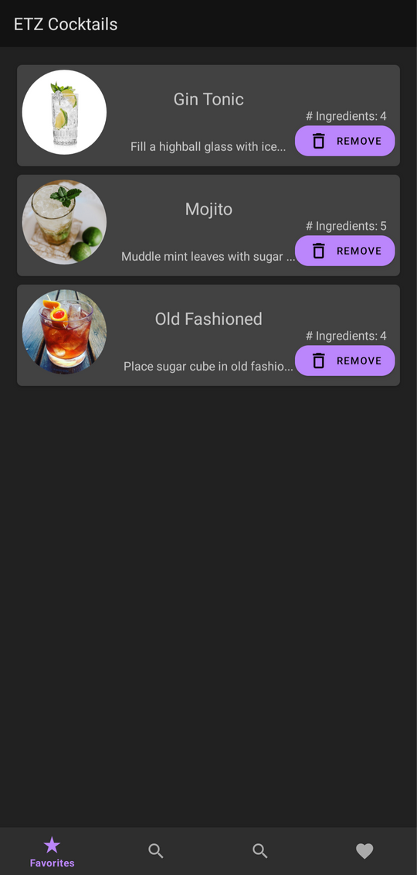
NO FAVORITES VS HAVE FAVORITES

Slide 15
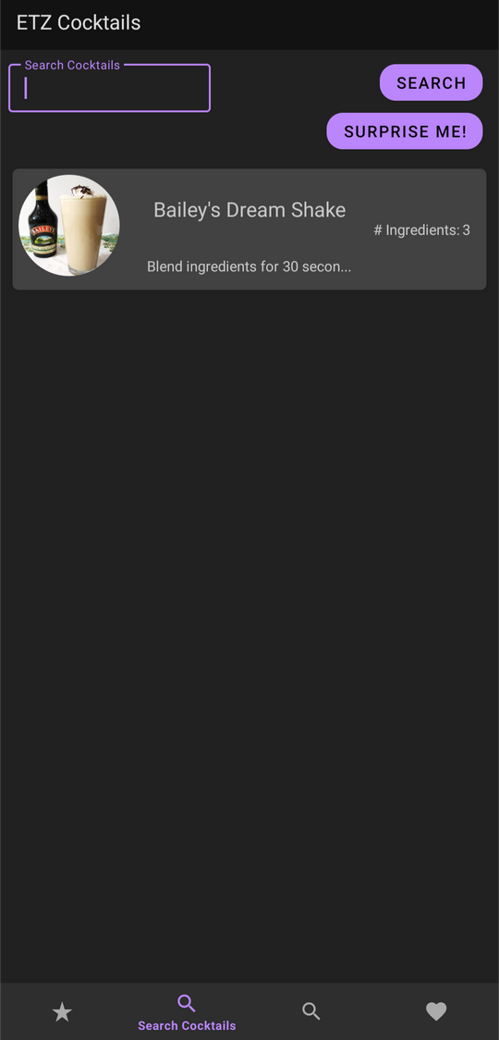
SEARCH BY NAME , INGREDIENT AND SURPRISE ME!

Slide 16
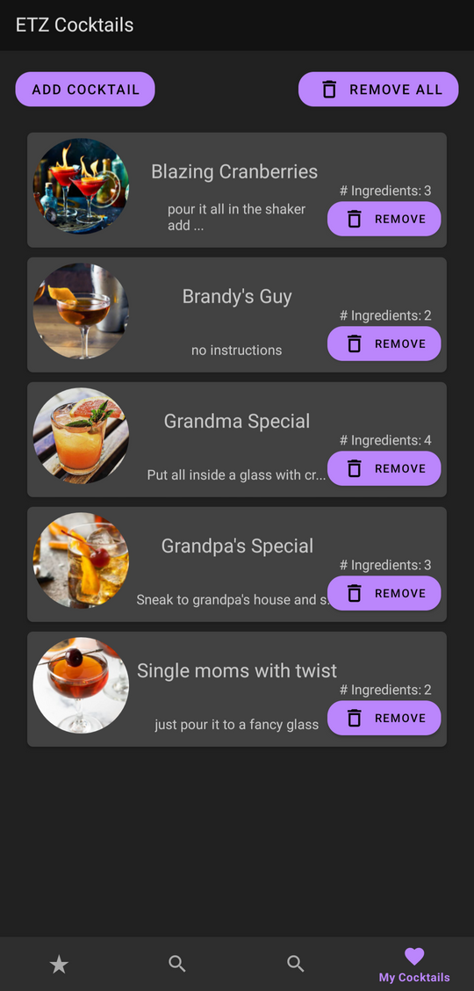
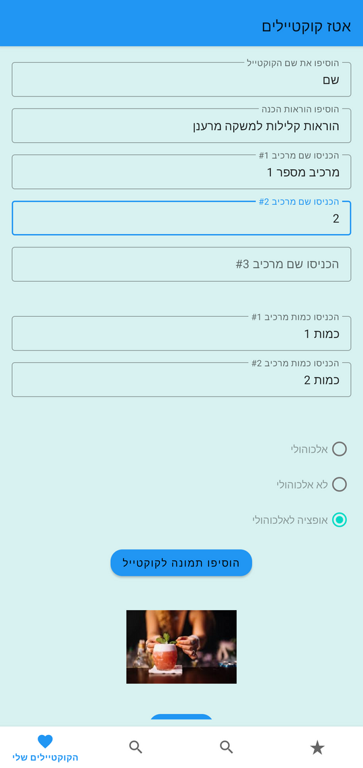
MY COCKTAILS + ADD NEW COCKTAIL

Slide 17
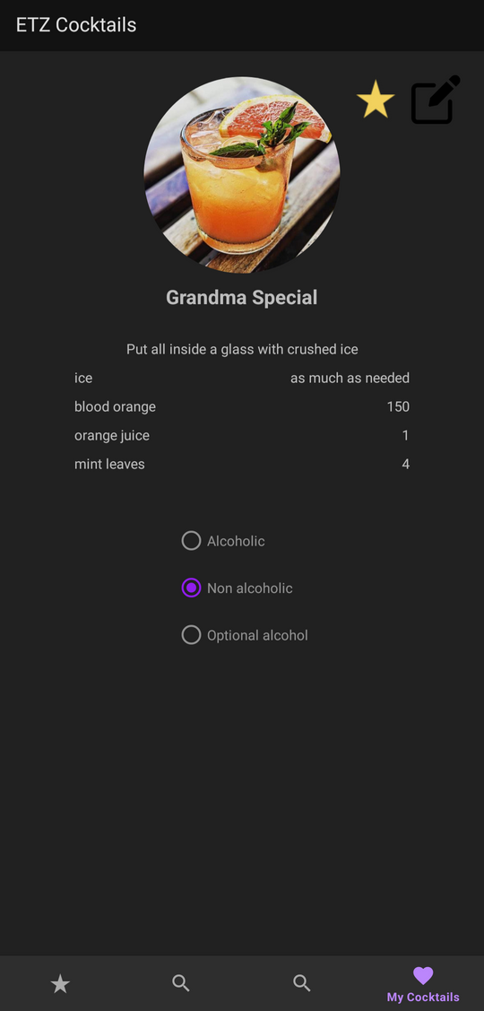
VIEW OF SINGLE COCKTAIL

Slide 18


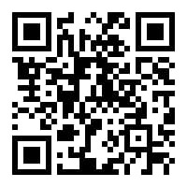
NEED MORE INFO ?
OUR GITHUB LINK
YOUTUBE PREVIEW LINK
DRIVE ZIP FILE LINK

Slide 19
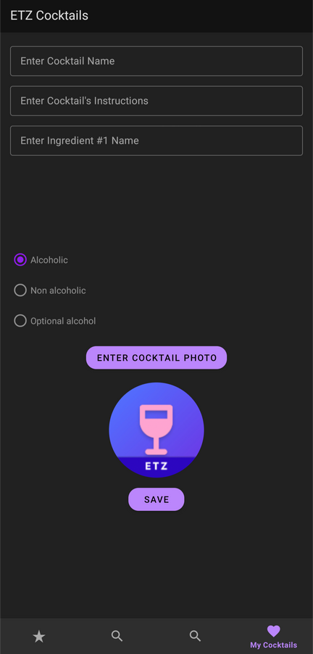
THANKS FOR
WATCHING
ETZ COCKTAILS APP FOUNDERS.

